Slide 1
READ the following quote.
“A friend is someone who knows all about you and still loves you.”
-- Elbert Hubbard
THINK about what qualities you look for in a friend.
WRITE about an important friend you have in your life. that friend so special.
Explain what makes
Be sure to-
clearly state your central idea
organize your writing develop your writing in detail choose your words carefully
use correct spelling, capitalization, punctuation, grammar and sentences

Slide 2
READ the following description.
A healthy lifestyle can help you feel physically strong and give you more energy. It can also lift your mood and keep you from getting sick. For these reasons, many people try to live a healthy life.
THINK about ways you can be healthy.
WRITE about living a healthy life. Explain what steps a person can take to be healthy.
Be sure to-
clearly state your central idea
organize your writing develop your writing in detail choose your words carefully
use correct spelling, capitalization, punctuation, grammar and sentences

Slide 3
READ the following description.
A community is a place where a group of people lives and works together. It can include homes, businesses, and parks. Sometimes people see a problem in their community. They work to help fix the problem and make the community a better place. When this happens, everyone in the community can benefit.
THINK about ways to improve your community.
WRITE about a problem you can solve in your community. steps you will take to make your community a better place.
Explain the
Be sure to-
clearly state your central idea
organize your writing develop your writing in detail choose your words carefully
use correct spelling, capitalization, punctuation, grammar and sentences

Slide 4
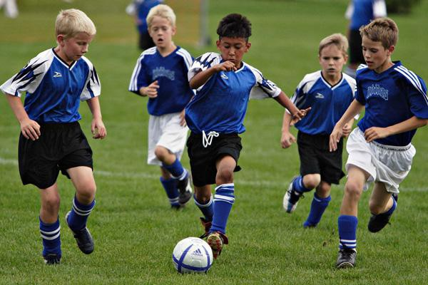
LOOK at the following picture.
THINK about an activity you enjoy doing.
WRITE about your favorite hobby or sport. favorite activity.
Explain what makes it your
Be sure to-
clearly state your central idea
organize your writing develop your writing in detail choose your words carefully
use correct spelling, capitalization, punctuation, grammar and sentences

