Slide 1
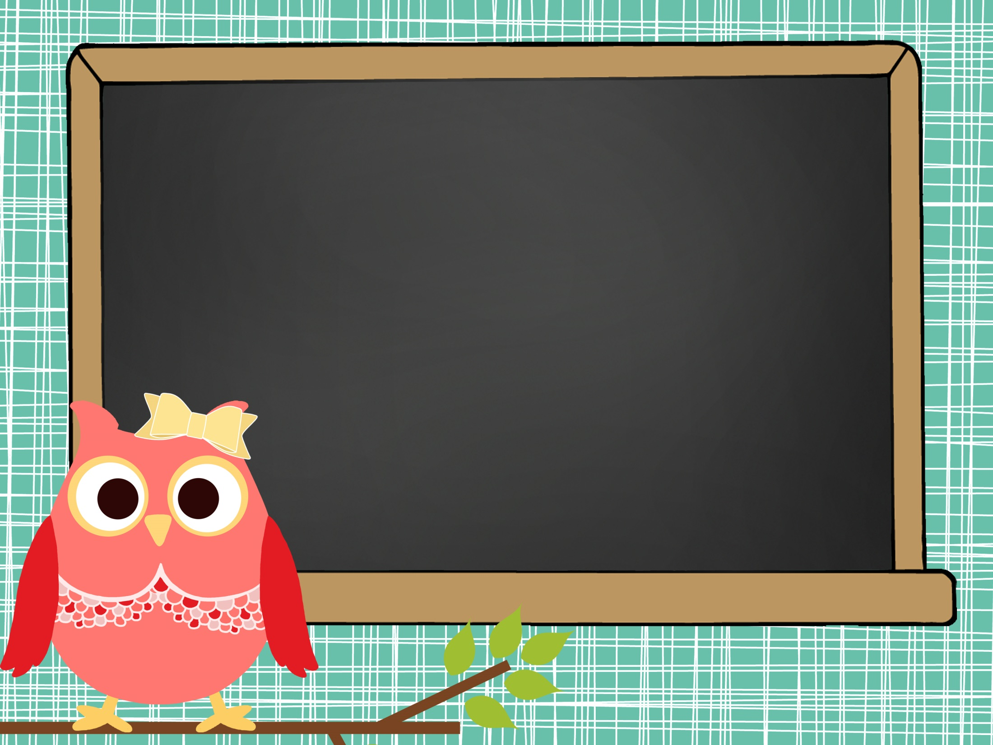
Welcome to Ms. Starling’s Class
Before you go:
Write down my classroom website for content we are learning in class/class updates: missstarlingclass.weebly.com and follow me on twitter: @missstarling3
- Feel free to write a note to your child in their Writer’s Notebook
Please look through their notebooks to see all the awesome things we are learning this year!
Hello. My name is

Slide 2
Ms. Starling’s Expectations!
 | Safety | Ownership | Attitude | Respect
Classroom | Follow instructions and directions | Take responsibility for your own actions and choices | Be positive | Support class members’ ideas, opinions, and contributions.
Hallway | Move in an orderly manner without talking | Quiet in the hall | Stay calm | Pass quietly in the hallways
Cafeteria | Keep your area clean | Clean up | Wait patiently in line and clean up | Keep voices down and use good manners
Bus | Remain seated at all times and follow bus driver’s directions | Gather your belongings | Listen to bus driver and follow rules | Use appropriate language and volume.
Recess Area | Follow safety rules | Use equipment as intended | Be a problem solver | Include others
Bathroom | Use facilities appropriately | Clean up after yourself | Be considerate and be an upstander | Maintain privacy of others.

Slide 3
Lady or Gentleman of the Week
Each week, I will randomly select a Lady or Gent to help out in the classroom.
Responsibilities:
Pass out papers
Line Leader
Clean Up Patrol Classroom and Lunch
Homework Manager (checklist for turned in homework)
Red folders in mailbox

Slide 4
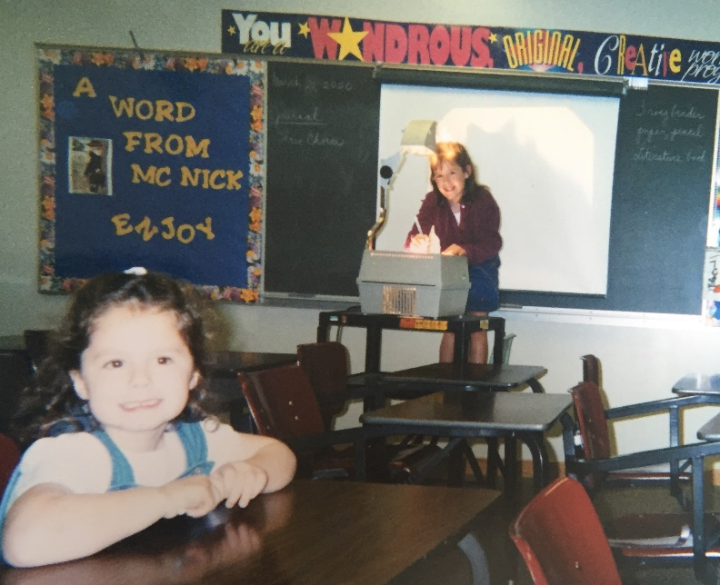
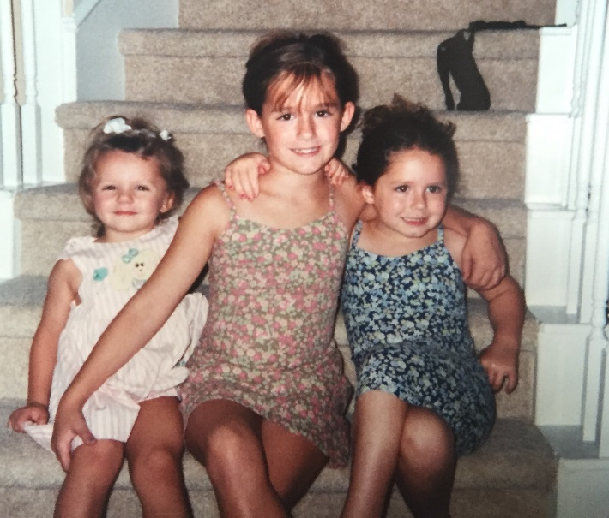
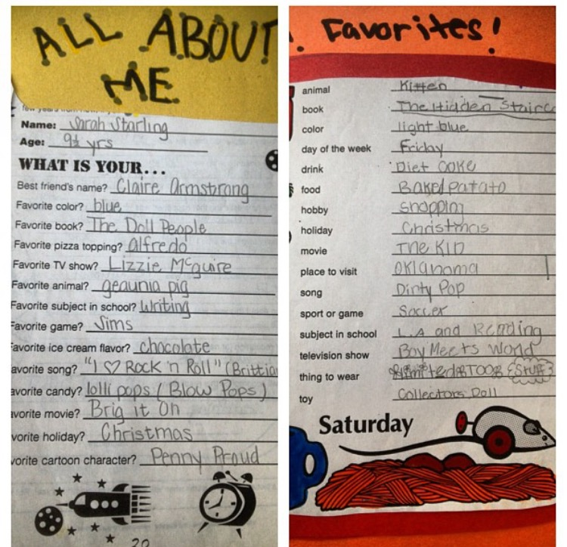
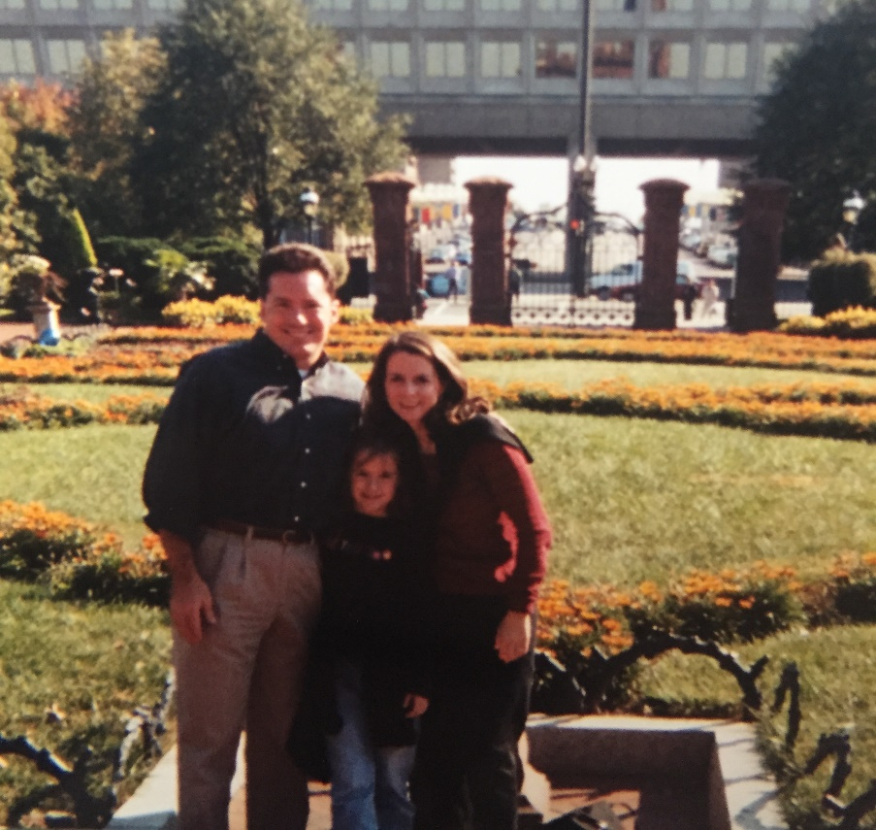
When Ms. Starling was in elementary school…
1.
3.
2.
1. Playing school at my grandma’s school (I’m the teacher)
2. All about me!
3. Posing with sisters!
4. Visiting D.C. with my parents!
4.

Slide 5
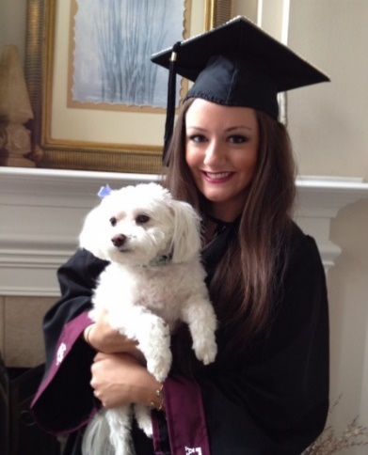
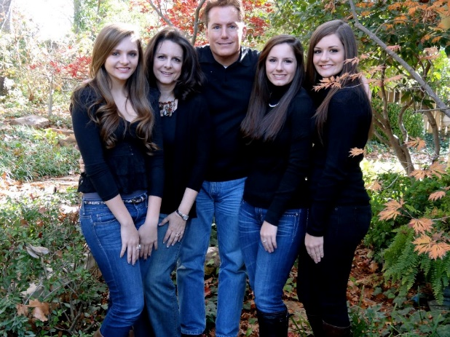
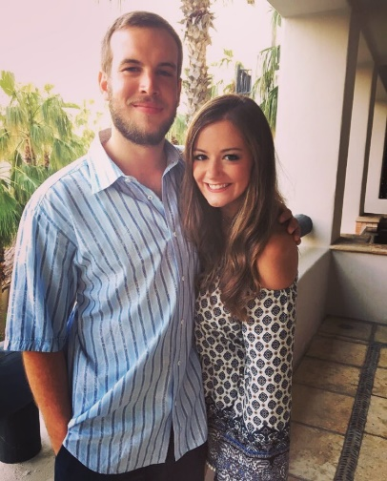
About ME, Ms. Starling:
I graduated from Texas A&M. Whoop!
I have always wanted to be a teacher!
I am the oldest of three girls. My sisters attend UT!
I love to travel! I have been to Australia, France, Italy, Ireland, and Switzerland. I studied abroad in London.
This summer I went to costa Rica, Colorado, NYC, and Boston!
Inspiring kids is my greatest passion!
I believe in progress, not perfection!
Goldfish and Diet Coke are my favorite.
- I think owls are super cute.
- I have a tiny dog named Maggie.
- My first year I taught 4th Grade L.A./S.S.
- This is my third year to teach!

Slide 6
Open Door Policy
Welcome to 5th Grade! I am so excited you are here!
Please feel free to contact me.
Room number: 209
E-mail: sarah.starling@springbranchisd.com
Twitter: @missstarling3
Website: www.missstarlingclass.weebly.com

